Slide 1

Topic : New Cars in ackodrive website
Problem Statement : Price Analysis

Slide 2
ABOUT US :
NAMES:
Pavankalyan Thatipamula (MBA)
ShivaSai Yeligeti (B.tech)
WHY DO WE WANT TO LEARN DATA SCIENCE ?
As Data Science is a board career path that is undergoing developments which promises abundant opportunities in the future.
EXPERIENCE :
Freshers

Slide 3
PROBLEM STATEMENT :
Buy a desirable New Car in affordable price.
Based on Price, Type, Model, Transmission, Engine and Fuel type we are going to recommend which model of new car is best.

Slide 4
PROCESS FOLLOWED :
Importing Libraries
Data Collection
Web Scrapping
Data cleaning
Data Analysis
Uni-variate Analysis
Bivariate Analysis
Multi-variate Analysis
Observation

Slide 5
LIBRARIES USED
1. Data Collection:
Requests, Beautiful soup, Pandas, NumPy, RE
2. Data Cleaning:
Pandas, RE(Regular Expressions)
3. Data Visualization:
Seaborn, Matplotlib

Slide 6

DATA COLLECTION:
Website :
Data Scraping link:
https://ackodrive.com/cars/page/1/

Slide 7
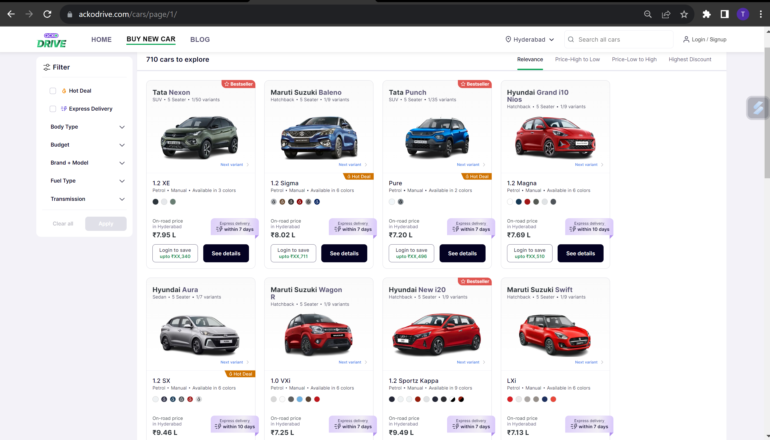
WEBSITE VEIW:

Slide 8
STEPS FOLLOWED TO COLLECT THE DATA:
Find the URL that you want to scrape.
Inspecting the Page.
Find the data you want to extract.
Write the code.
Run the code and extract the data.
Store the data in the required format.

Slide 9
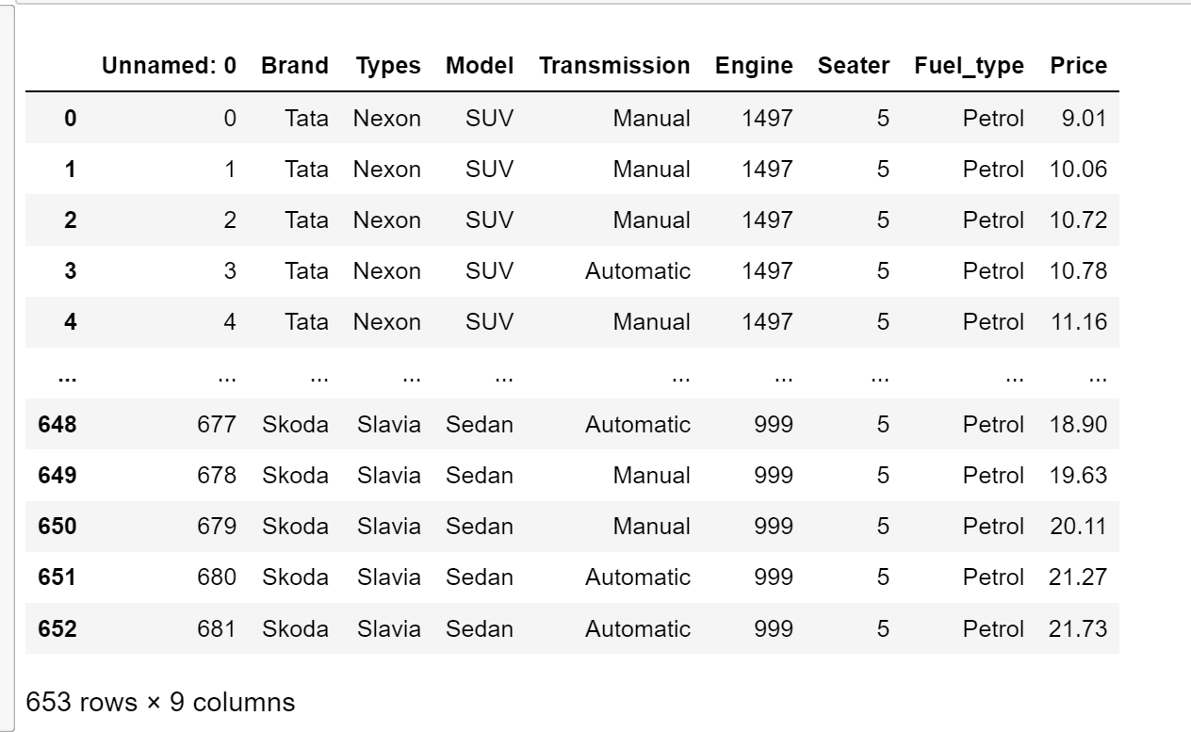
RAW DATA FRAME :

Slide 10
DATA CLEANING :
Identifying Null values.
Identifying Missing values.
Removing special symbols.
In place of null values, we imputed mean & median depending on the data.
Treating columns and converting required columns from object to int or float datatype.

Slide 11
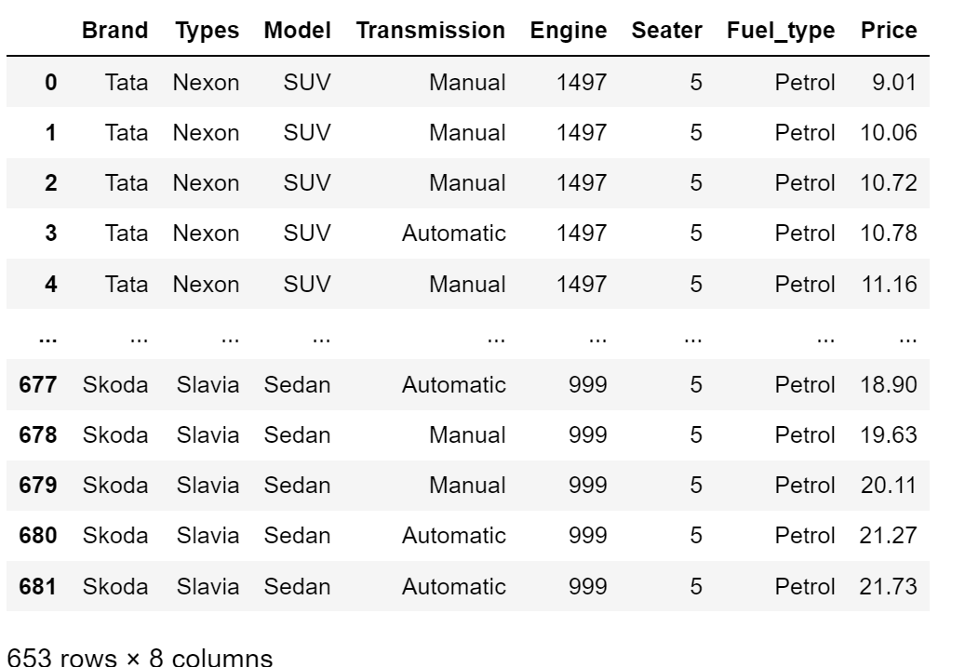
CLEANED DATA FRAME:

Slide 12
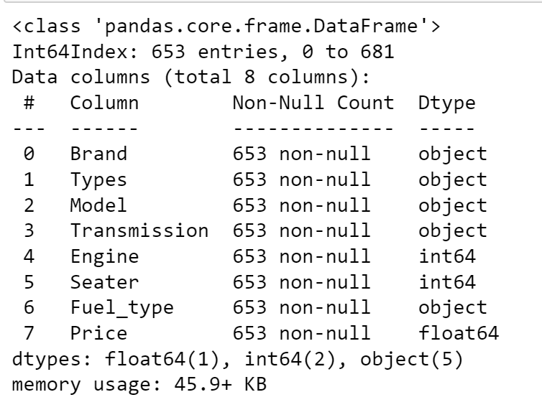
INFO, DUPLICATES, NULL VALUES :
We can now observe, that after performing data cleaning on data frame we have no null values in the data now.
The necessary columns’ conversion from object to int or object to float is likewise finished.

Slide 13
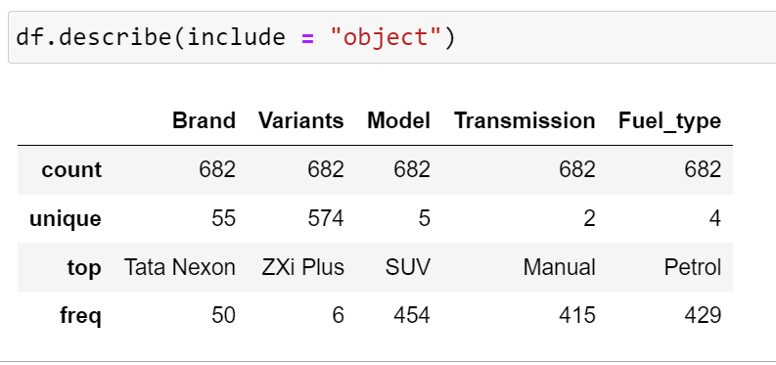
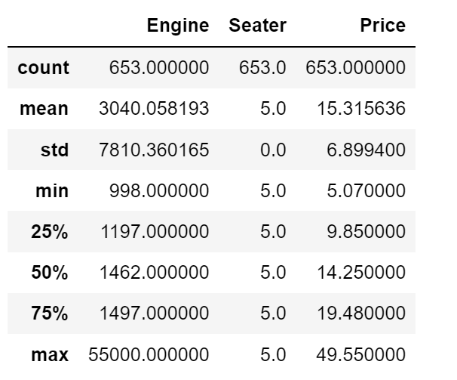
DESCRIBE :
By using, describe function we can know min, max, std percentile ranges of columns containing numerical data.

Slide 14
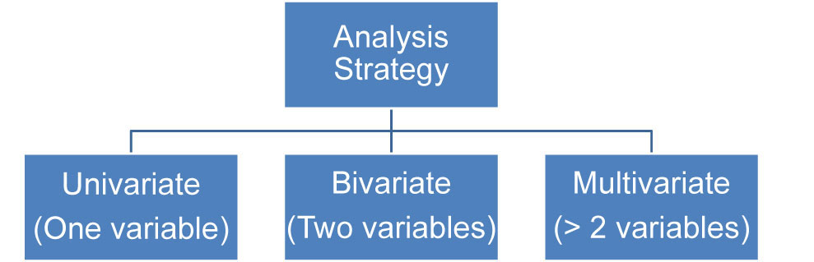
DATA VISUALIZATION :
1. UNI-VARIATE:
1.1 Single categorical
1.2 Single numerical
2. BI-VARIATE:
2.1 Categorical-Numerical
2.2 Numerical-Numerical
2.3 Categorical-Categorical
3. MULTI - VARIATE:
More than two columns we can take
3.1 Categorical-Numerical-Categorical
3.2 Categorical-Numerical-Numerical
3.3 Categorical-Categorical-Categorical
3.4 Numerical-Numerical-Numerical

Slide 15
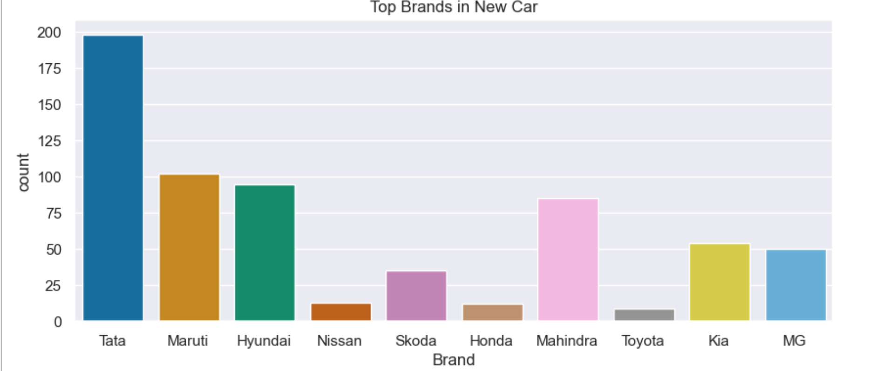
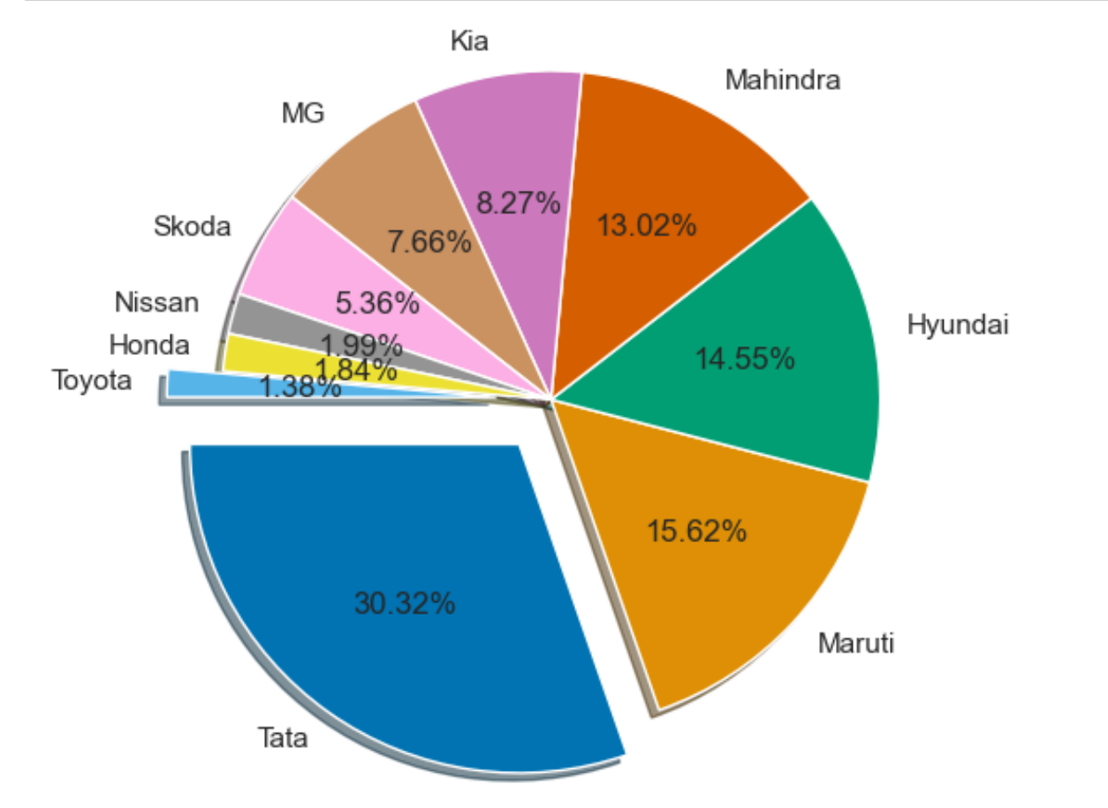
WHICH BRAND HAVE HIGH COUNT:
From the below count plot, we can observe the top 10 Brands of New cars.
Tata Brand has the highest count and occupied the first place. And it occupied the top most place and Maru ranked second top Brand in our data in the market.

Slide 16
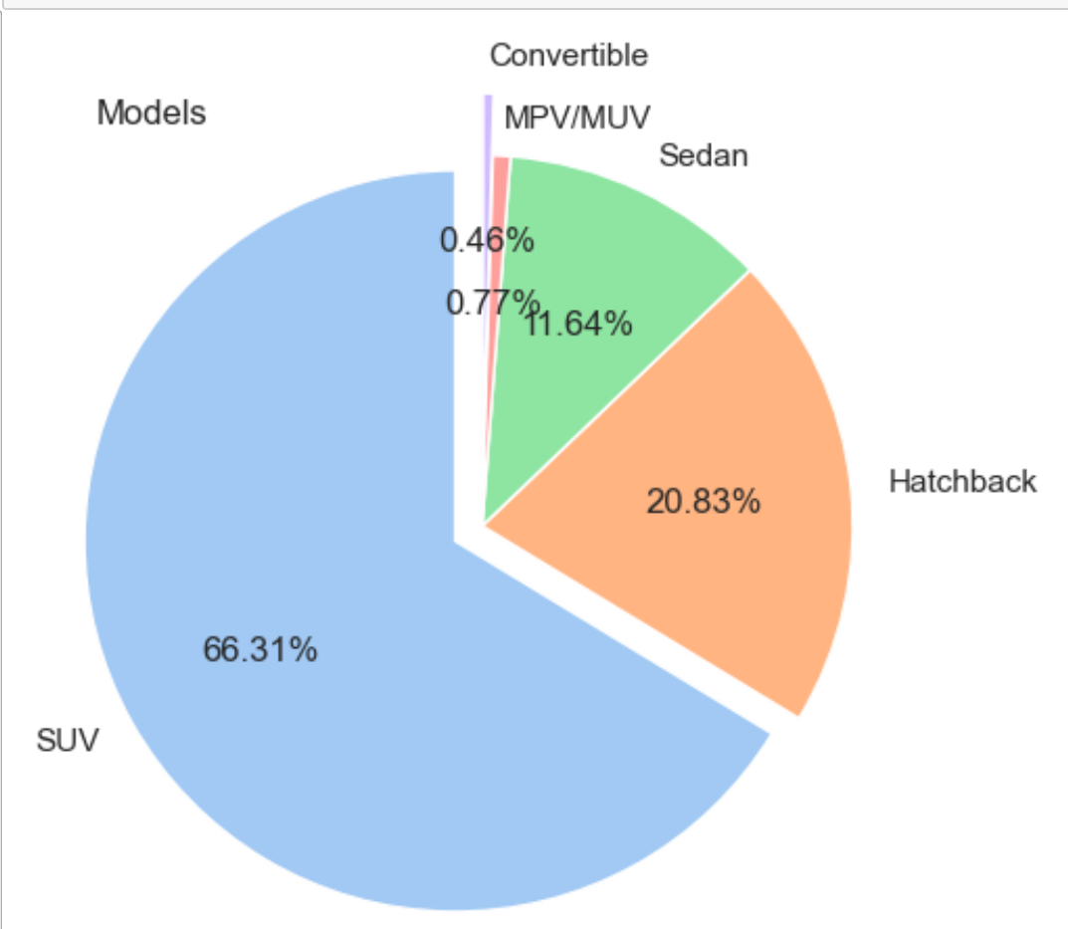
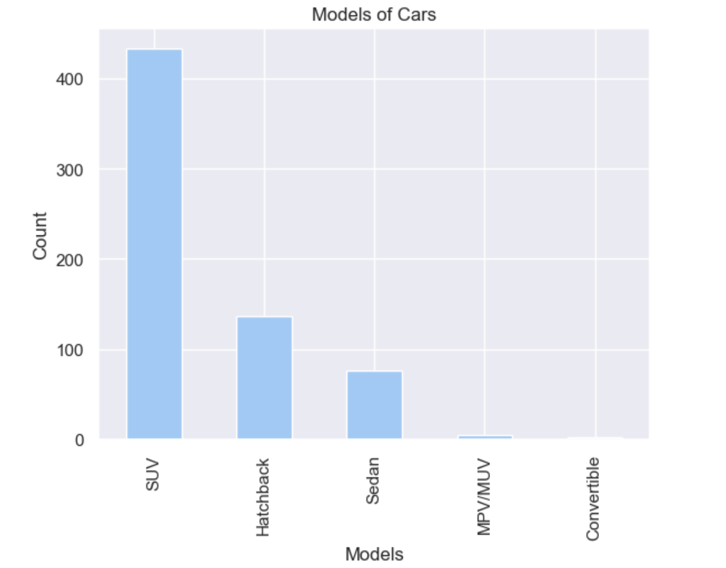
WHICH MODEL WAS HIGH:
SUV: The most common Models in the dataset is SUV with a count of 433. SUV stands for Sports Utility Vehicle, a car similar to a minivan or a station wagon, but with a much tougher look and a design suited for off-road driving.
Convertible ,MPV/MUV models have relatively lower counts in the dataset, with Convertible at 0.46%, MPV/MUV at 0.77%, These could be less commonly used models in New Cars.

Slide 17
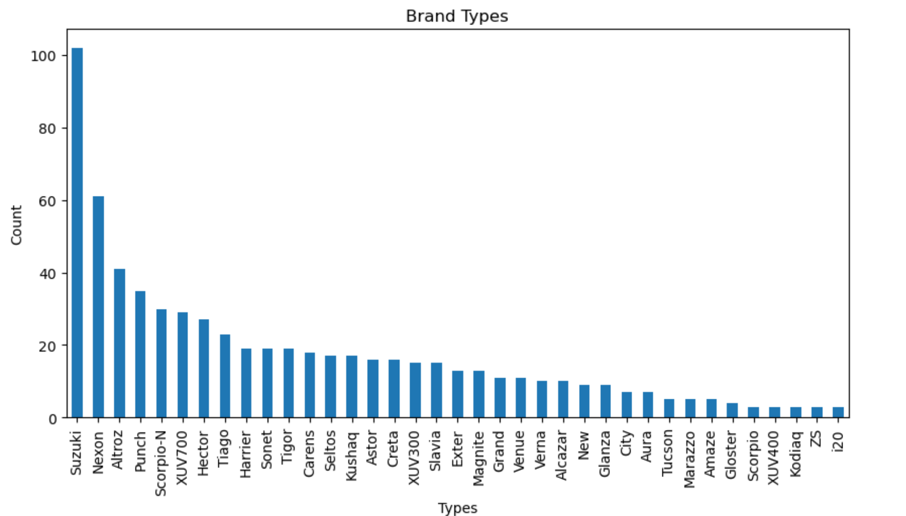
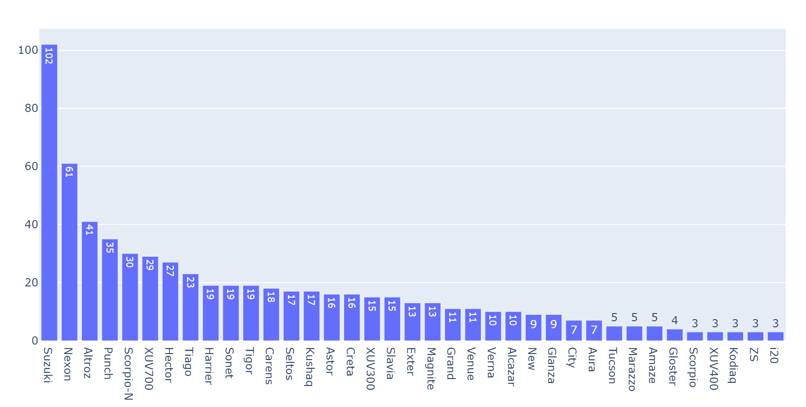
WHICH BRAND TYPE WAS HIGH :
Suzuki: The most common Brand Type in the dataset is Suzuki, with a count of 102.
i20,ZS,Kodiaq,XUV400,Scorpio are the lower Brand types in the Dataset with count of 3 .

Slide 18
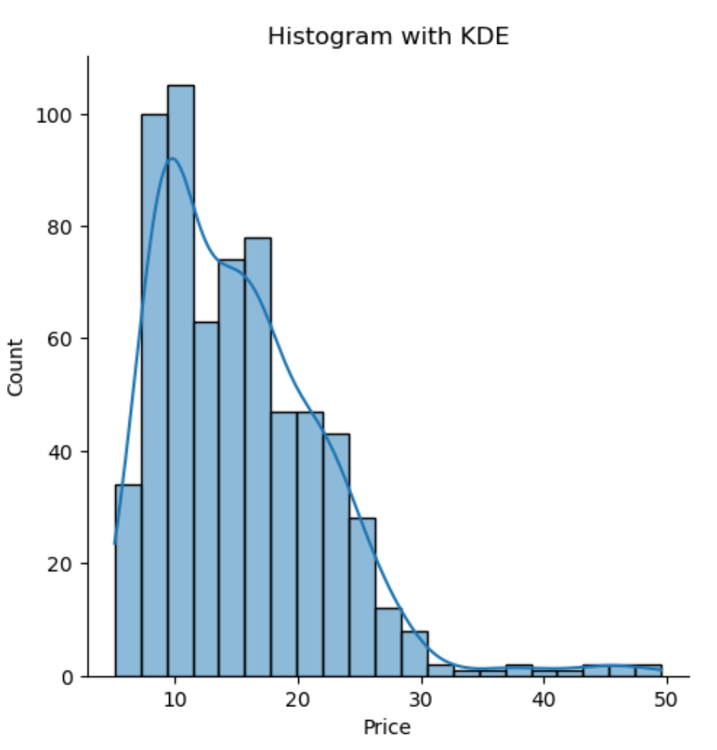
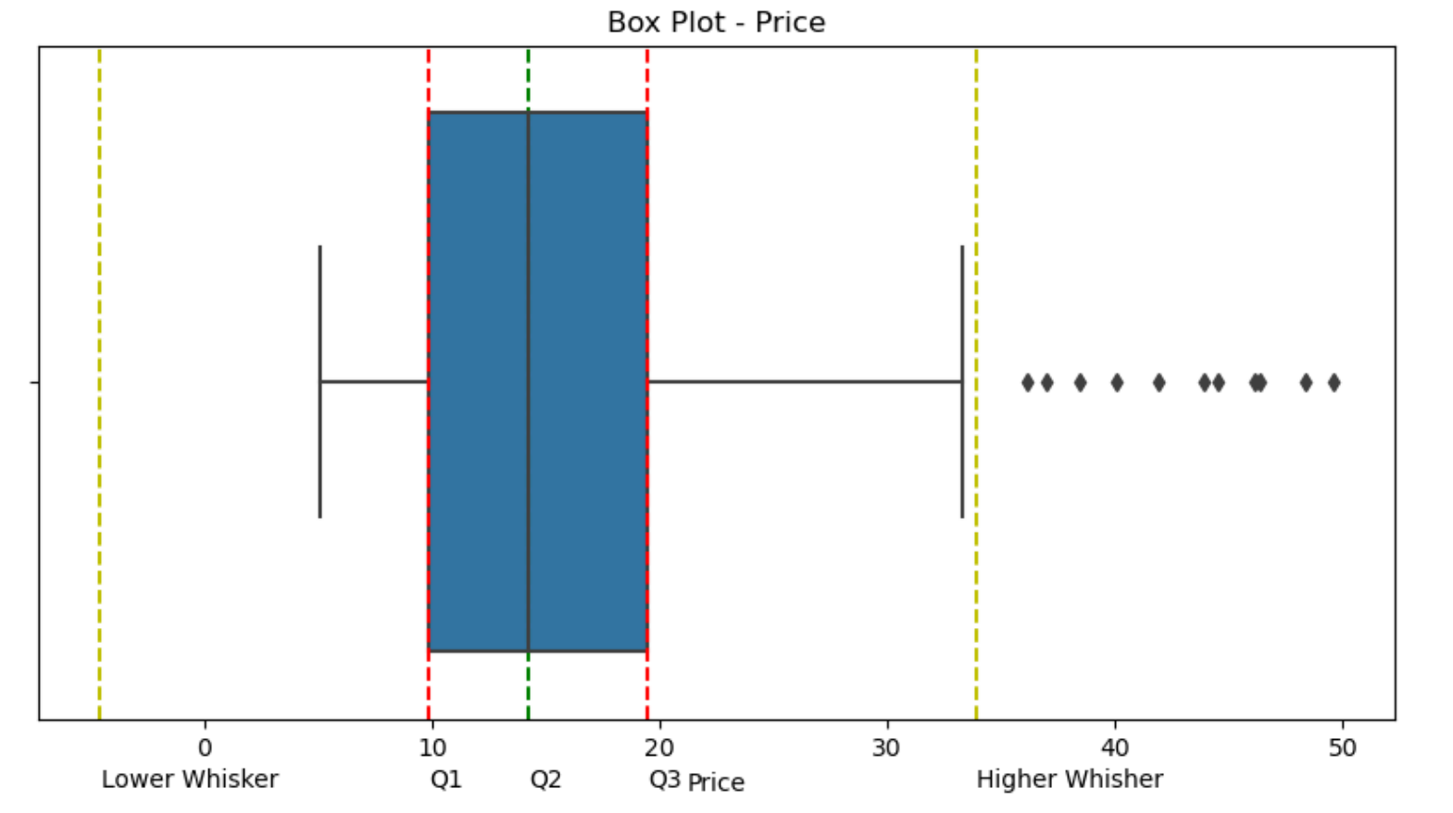
DENSITY OF PRICE (LAKHS) :
The above charts illustrate the density Cars available from price range of Rs.10L to 50L.
The Histogram with KDE plot describes that majority of Cars are under the price range of Rs.10L to 20 L.
Box plot identifies the decline in the density of TVs which fall under Rs.10L to 20L category.

Slide 19
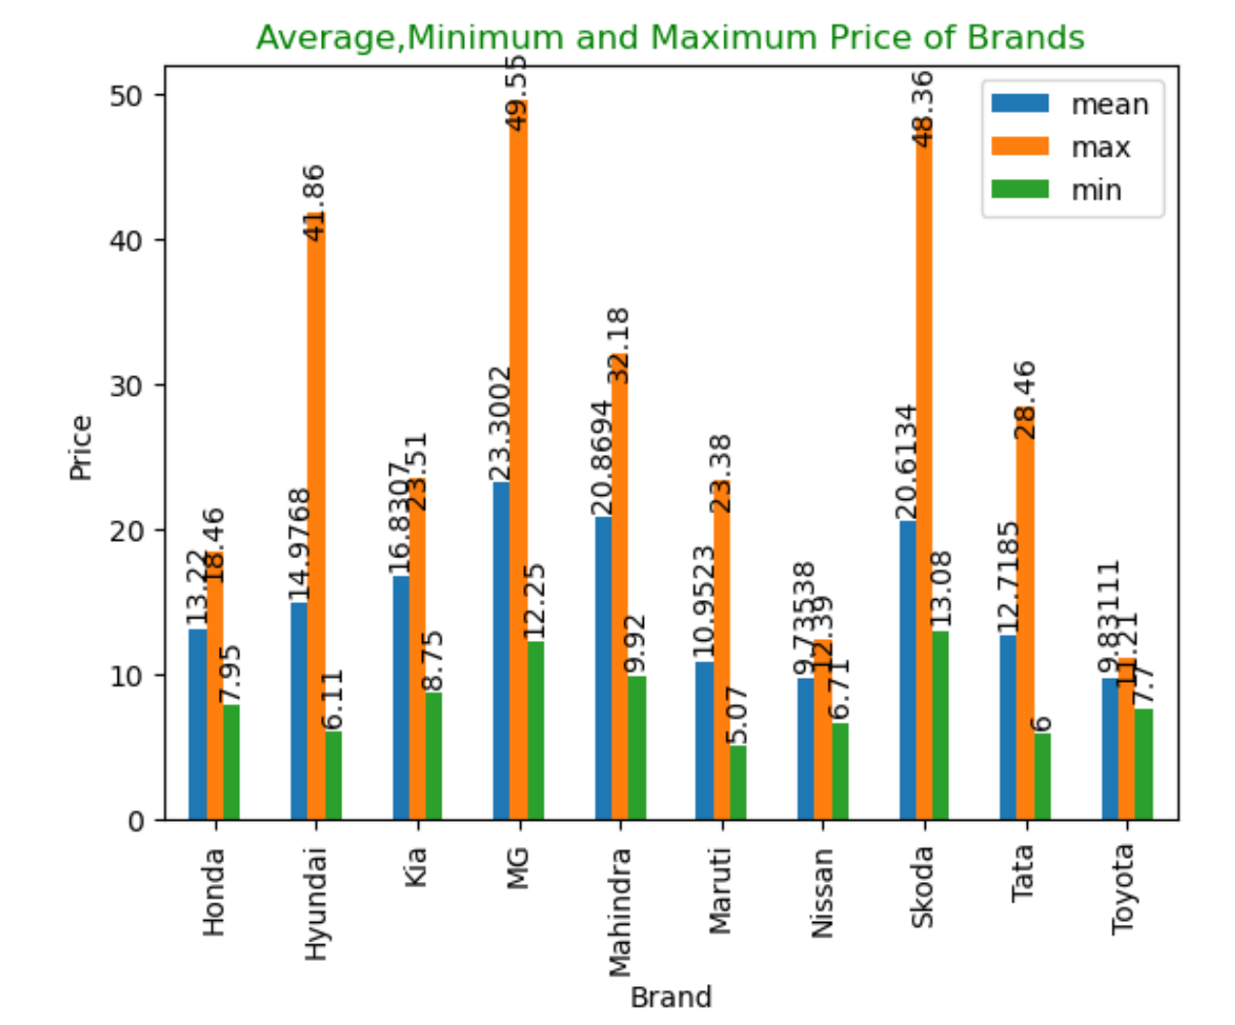
Brand wise Average, Minimum & Maximum Prices :
The Grouped-bar graph illustrates the Minimum, Maximum and Average Price’s
of different Car brands available on Acko-Drive.
From the graph , it can be seen that
MG Brand have maximum Price of 49,55 lakhs, Average Price of 23.3 lakhs and
Tata Brand have lower price with minimum price of 6 lakhs.
.

Slide 20
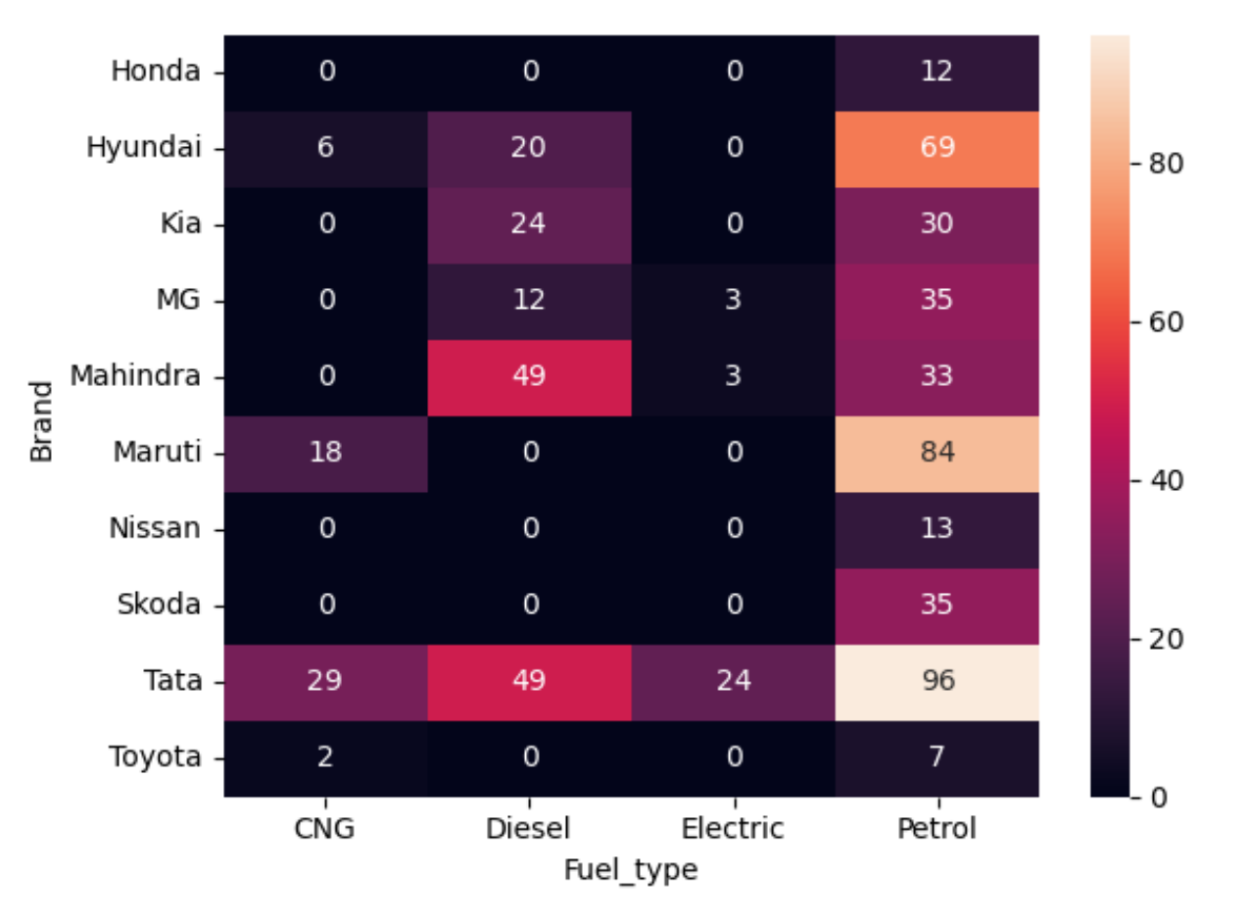
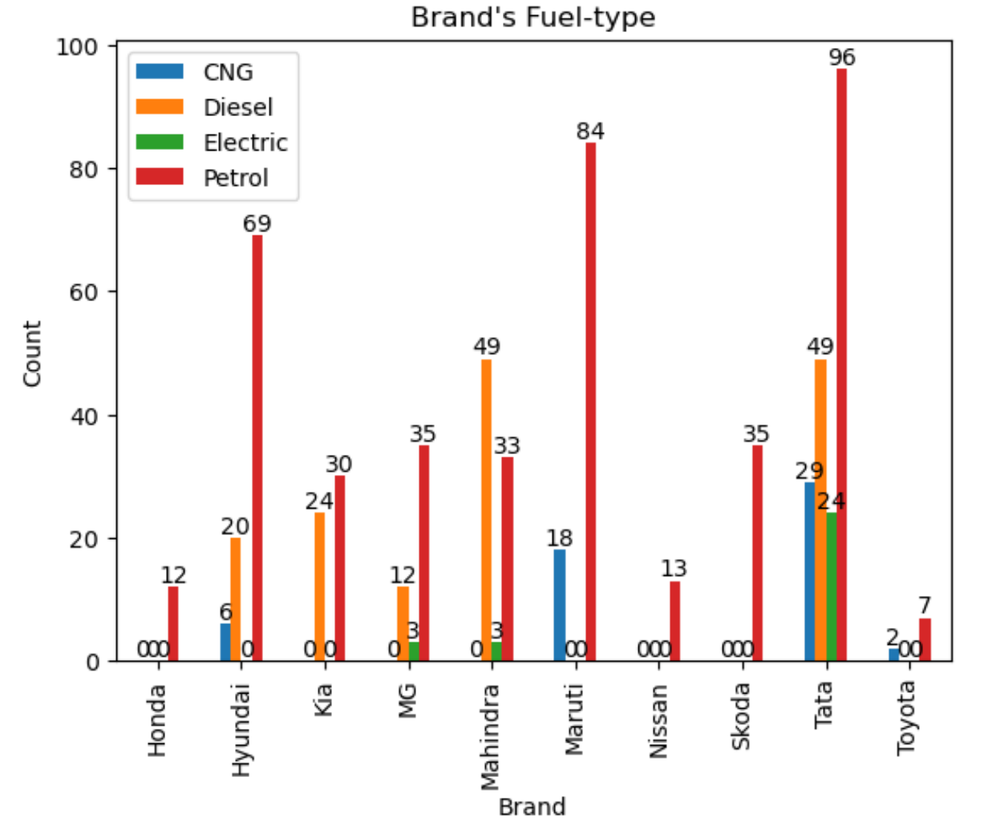
DENSITY OF PRICE (LAKHS) :
The above bar plot portrays the Fuel-types based on their brands.
From the above bar graph,
Tata Brand have all FUEL-TYPES i.e CNG,DIESEL,ELECTRIC,PETROL
Honda, Nissan & Skoda Brands have only one FUEL-TYPES i.e PETROL
From Heatmap and Grouped-bar plots :
Petrol Cars are most available cars in every Brand.
Diesel Cars second most available cars and next CNG and Electric cars.

Slide 21
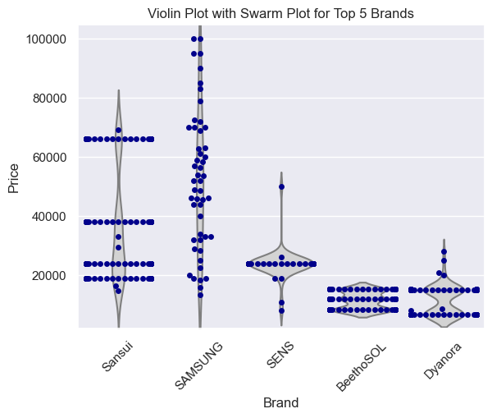
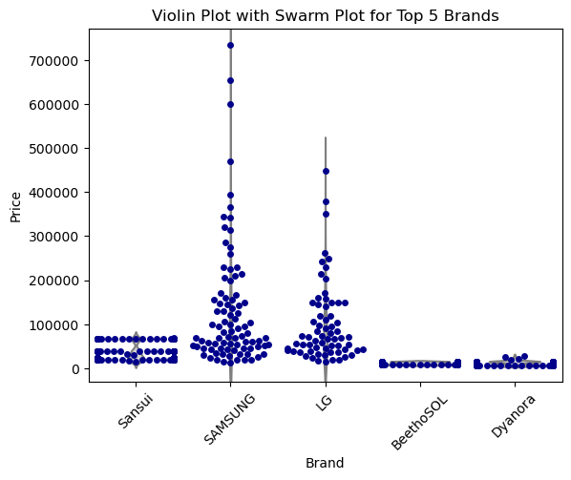
Violin Plot with Swarm Plot for Top 5 Brands :
Insights:
From below plot we can observe the swarm plot of top 5 brands present in our data frame with Prices.
Almost all brands price are present in between 1L.
The Samsung has available in all prices from low to high and little same as LG.
The remaining brands are almost present in the 1L.
Insights:
We can observe the data that almost present in 1L.
So, we can filter the data that the price in between 0 to 1L.
We can observe the above plot that easily understand and clear when compare to the beside plot.

Slide 22
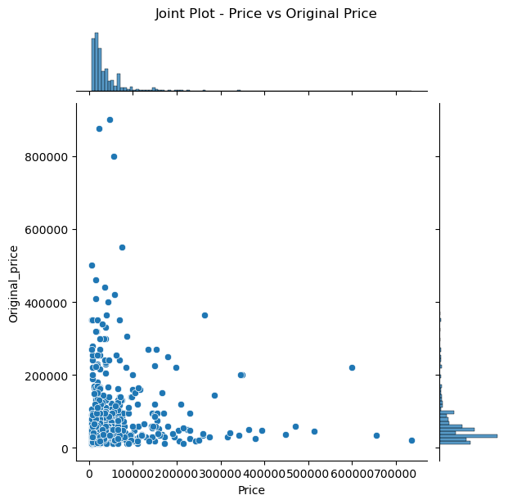
This above graph is a joint plot between price of TV offered and original price it actually costs.
It shows that between maximum price range is in between Rs.1000-2,00,000. Price of TV offered is almost same as original price.
But, the TV which are high-priced do vary from original price, i.e good amount of offer has been given to high-priced TVs.

Slide 23
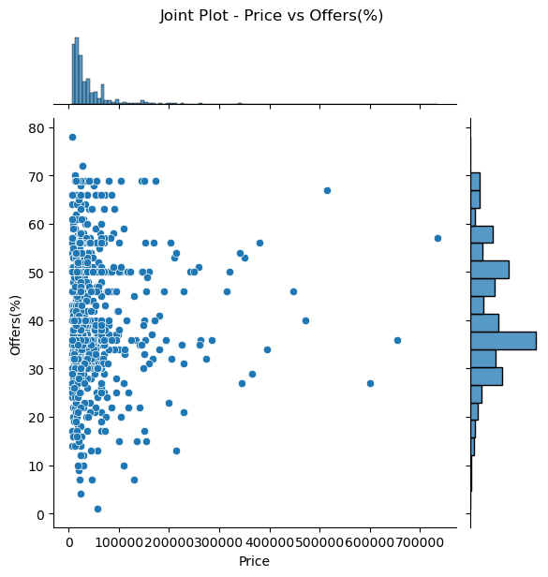
This above graph is a joint plot between price of TV and %discount given of what it actually costs.
It shows that after majority of the TVs are given discount of 10-70%, price range became Rs.1000-2,00,000
The TVs which are high-priced are given good discount of 40-70%

Slide 24
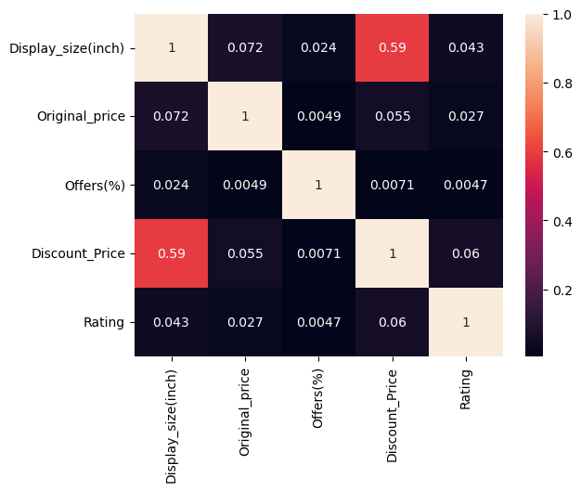
CORRELATION:
From the above plot, we can observe that Display_size(inch)and Price are mostly positive correlated means if Display_size(inch) is increased the price is also increased and there are no negatively correlated variables.

Slide 25
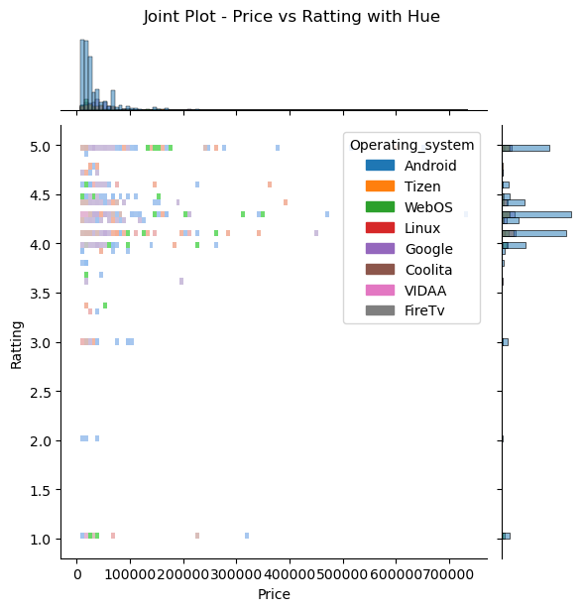
The graph illustrates the rating made by the consumers to different smart TV based on price of TVs available on Flipkart.
From the above data, it can be seen that TVs under price range of Rs.0 to 200000 are rated high, which shows that customers favour this price range more than others.

Slide 26
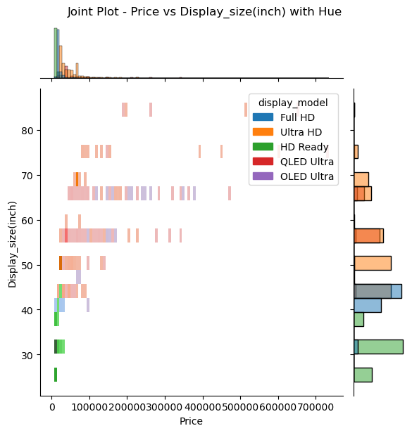
The graph illustrates the rating made by the consumers to different smart TV based on price of TVs available on Flipkart.
From the above data, it can be seen that TVs with display size of 15-80 inch fall under price range of Rs.0 to 500000.

Slide 27
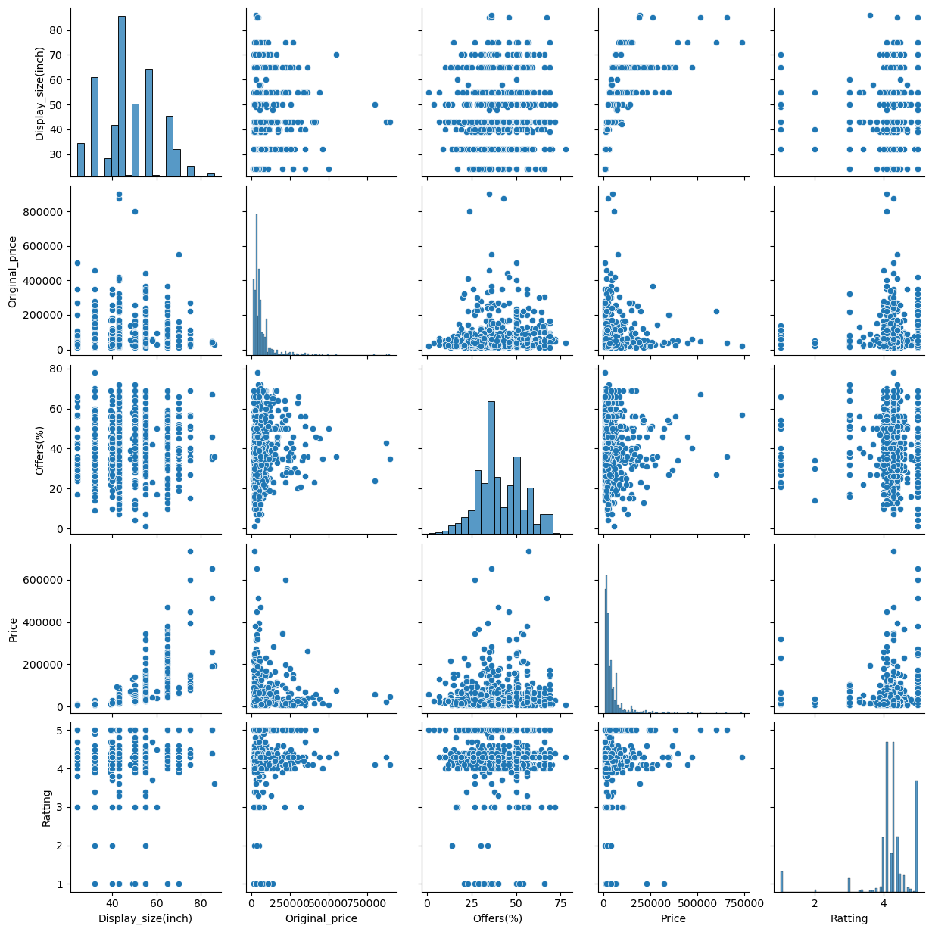
PAIR PLOT – BI VARIENT ANALYSIS :

Slide 28
From the EDA and Data Visualization the following conclusions can be drawn :
Sansui Brand smart TV has the highest count in market.
Android: The most common operating system in the dataset is Android with a count of 563. This suggests that a significant number of smart TVs in the dataset are running on the Android operating system.
The most common display model in the dataset is Ultra HD, with a count of 40.6%.
TVs with display size near to 70-80 inches range are quite less in number whereas 40-60 inches TVs are marketed more on the website.
Majority of TVs are under the price range of Rs.1000-20,0000.
From the above data, it can be seen that TVs with display size of 15-80 inch fall under price range of Rs.0 to 500000.

Slide 29
MarQ and VG TV brands are rated high, which shows that customers favour this TV brand more than others.
SAMSUNG TVs has a variety of models including low-priced to high priced touching the price of 1000 - 1,40,000. LG,SONY and CORNEA TV brands are next up in list of the high-priced TVs respectively.
The more economical TV brands being Sansui,Infinix, Mi, realme, BeethoSOL,Dyanora and more.
Using swarm plot we have seen that the top 5 brands - Sansui, SAMSUNG, LG, BeethoSOL, Dyanora.
Through heat map, we have seen that, Display_size(inch) of TV and Price are mostly positive correlated.
From the above data, it can be seen that TVs under price range of Rs.0 to 200000 are rated high, which shows that customers favour this price range more than others.

Slide 30

Thank You

